Slide 1
Building Robust Microservices with Spring Cloud
Moving beyond just simple, REST based services
John Carnell Genesys
Notes:
Explore and validate whether Unikernels are a viable option for use in PureCloud.
We are use unikernels to reduce deployment times for services

Slide 2
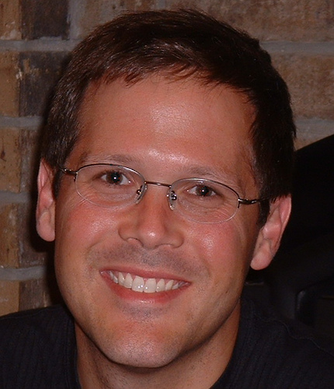
About the Speaker
JOHN CARNELL is a senior cloud engineer at Genesys, where he works in Genesys’s PureCloud division. John spends the majority of his day hands-on building telephony-based microservices using the AWS platform. His day-to-day job is designing and building microservices across a number of technology platforms including Java, Clojure, and Go.
John is a prolific speaker and writer. He regularly speaks at local user groups and has been a regular speaker on the “The No Fluff Just Stuff Software Symposium.” Over the last 20 years, John has authored, co-authored, and been a technical reviewer for a number of Java-based technology books and industry publications.
John holds a Bachelor of the Arts (BA) from Marquette University and a Masters of Business Administration (MBA) from the University of Wisconsin Oshkosh.
John can be reached at john_carnell@yahoo.com

Slide 3
Agenda
Quick overview
Building with your first microservices with Spring Boot
Configuration management with Spring Cloud Config Server
Service discovery and routing with Spring Cloud, Netflix Eureka and Zuul
Service resiliency with Spring Cloud and Hystrix
Event driven microservices with Spring Cloud Stream
Distributed service tracing with Spring Cloud Sleuth
Note: All code can be found at https://github.com/carnellj/spmia-chapter[1-10]
Notes:
How many of you guys are actively building microservice based applications
How many of you guys are Spring developers
Building them in the cloud

Slide 4
How many people think Microservices are hype?
Image sourced from Sander Hoogendoorn, Microservices, the Good, the Bad and the Ugly
Notes:
Gartner has always been dead on with this slide. For many microservice are clearly going through this cycle. However, I think microservices as an architecture are here to stay/ But I think that for many the use of microservices is making many realize that like any architecture microservices have benefits. Those benefits are high business velocity but also increased operational complexity. You can deliver features faster, but you have smaller moving parts.

Slide 5
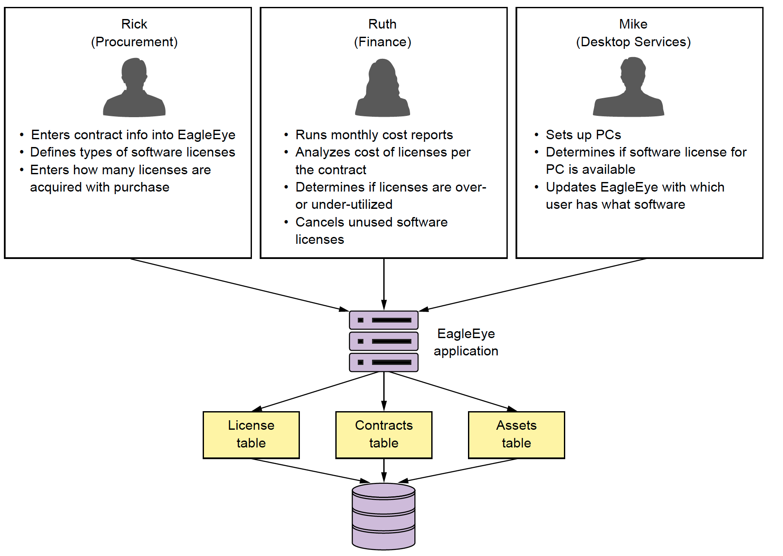
Lets build a Microservice: Start with a Problem
Notes:
Lets set the tone for the talk by setting the business problem. We have a small software company that makes licsense and asset management application. There traditional focus has been deliverying a monolithic web app, install on-premise to customers. They have a twice a year release cycle and it is killing the company in terms of getting the product out the door.

Slide 6
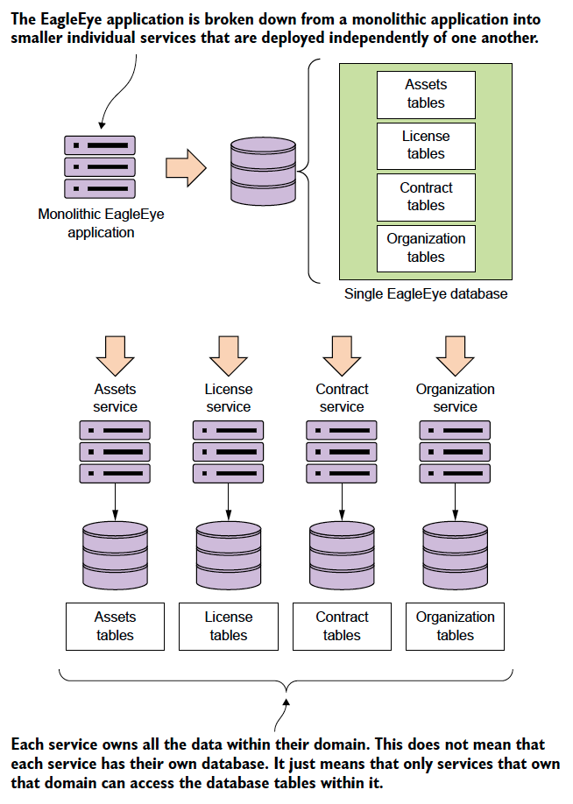
Microservices: Decomposing the problem
Microservice are small, distributed software components that are:
Independently developed, tested and deployed from other software components in an application.
Are built around evolved principles (REST, JSON) rather then committee-based standards (No XML)
Very limited in scope of responsibility
Completely own their data
Are usually deployed in a loosely coupled fashion with synchronous and asynchronous interfaces
Their small size allows for rapid development and deployment of new features
Microservices are really a nature extension to the Agile and Lean movement shaping the software industry over the last 15 years
Microservices are pushing us to smaller batch sizes!
Notes:
To transition: Building microservices are easy. Its like building blog site in 10 minutes. :-)

Slide 7
Building your first Microservices with Spring Boot

Slide 8
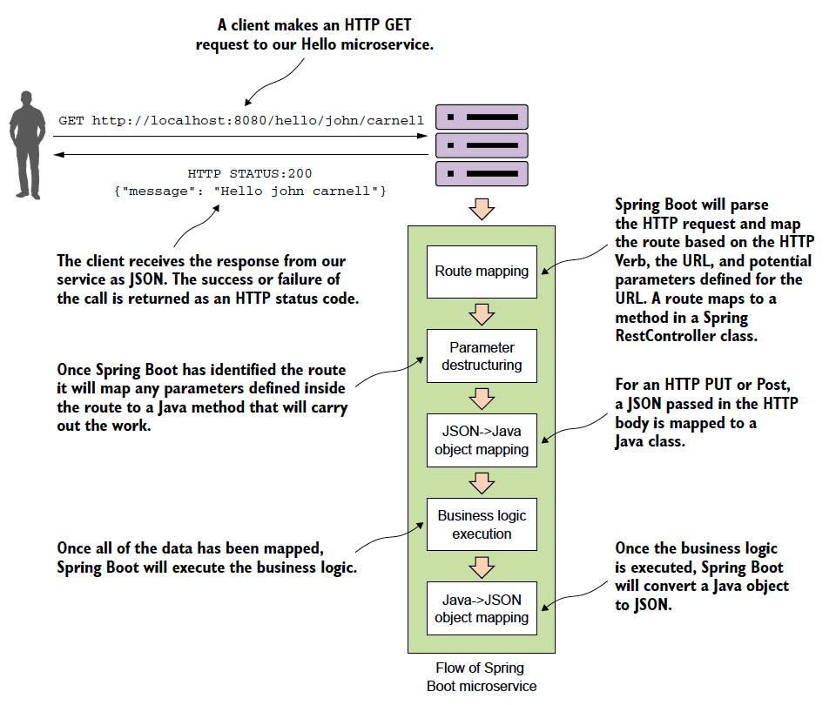
Lets build a simple service with Spring Boot
What is Spring Boot?
A slimmed down version of the Spring framework
Focuses heavily on building JSON-based, REST services
Annotation driven
Really geared towards building self-contained services that can be deployed as a single executable
Notes:
Spring Boot really simplifies development of REST-based services by focusing on annotation development. Spring MVC is a full blown, full stack web development framework. Spring Boot is a very light weight framework
mvn spring-boot:run

Slide 9
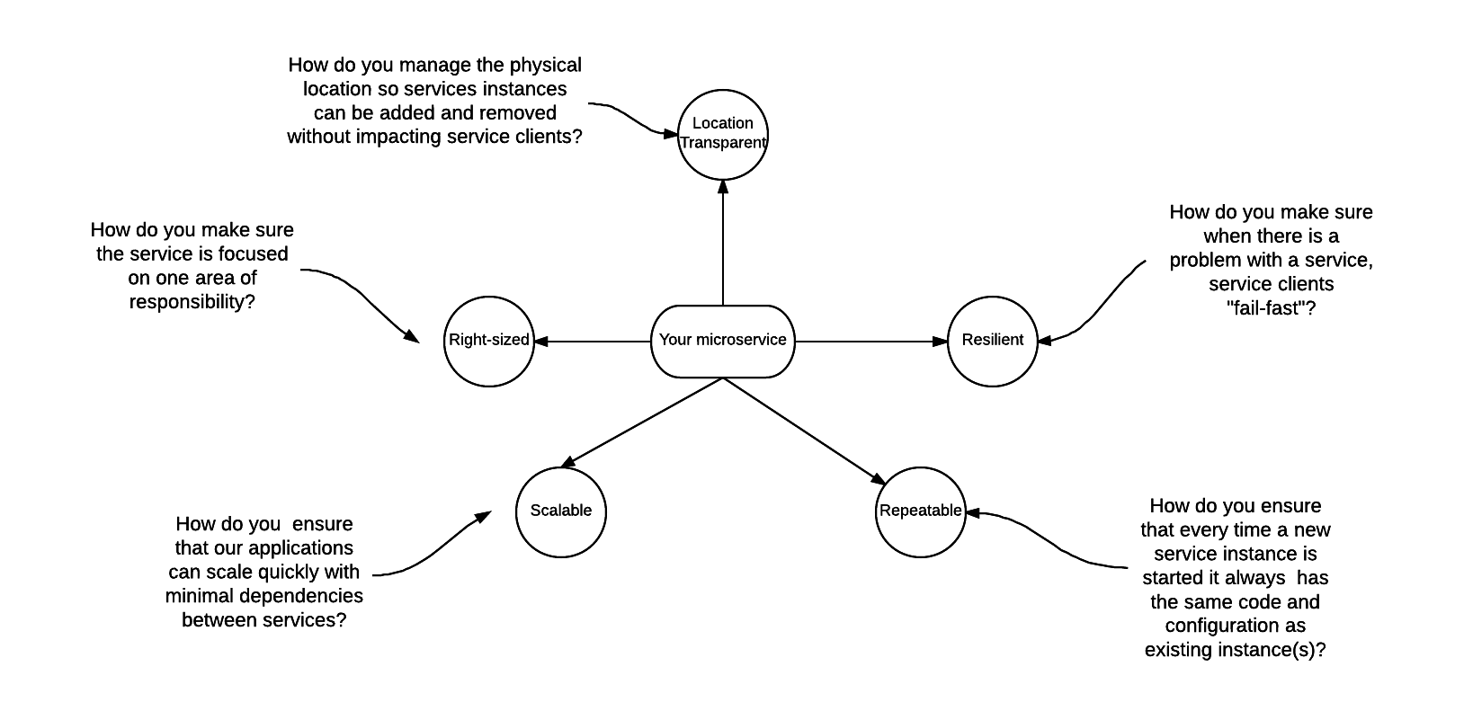
Microservices: Simple to Build, Operationally Complex
Notes:
A successful microservice architecture is not about building just the microservices. It is about thinking about what building all the infrastructure that surrounds the cloud. Its the operational ecosystem that your microservices run it that are going to help contribute to its success.

Slide 10
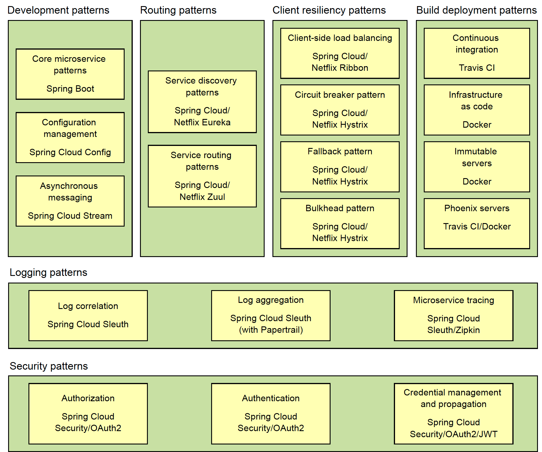
Enter Spring Cloud
What is Spring Cloud?
Spring framework that wrappers many open-source Microservice tools
Netflix
Consul
Geared towards making them easy to consume with Spring
The keyword is consumable.
Heavily annotation-driven
Almost everything is a service
Spring Cloud Config
Spring Cloud Service Discovery
Spring Cloud Routing
Spring Cloud Security
Spring Cloud Sleuth
Notes:
This is a very overloaded picture, but really when I wrote my book I wanted to organize the Spring Cloud technologies in. I am going to take you guys through a whirlwind tour of these technologies. The only ones we are not going to cover are the build/deployment and security patterns.

Slide 11
Configuration management with Spring Cloud Config Server

Slide 12
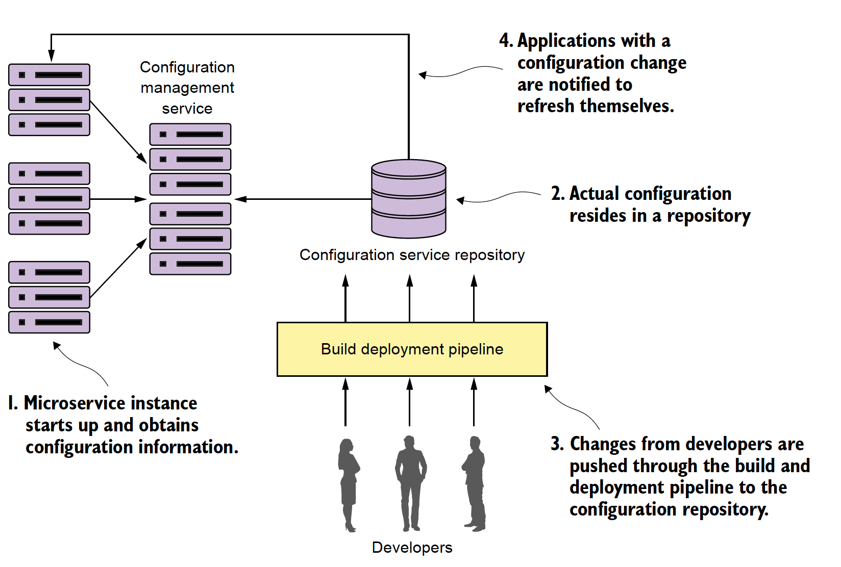
Lets Begin: Application Configuration
Application configuration management is a cornerstone of building a microservice application
Key principles of configuration management
Segregate
Abstract
Centralize
Harden
Human error and accidental complexity are real
Notes:
Start with the story of 12000 configuration files and websphere. Configuration drift is really.
I cant stress this enough. How you manage the configuration of your application is critical. A microservice is a small independent piece of code that is self-contained and can be deployed quickly and repeatedly. It should be immutable meaning the server should not be touched

Slide 13
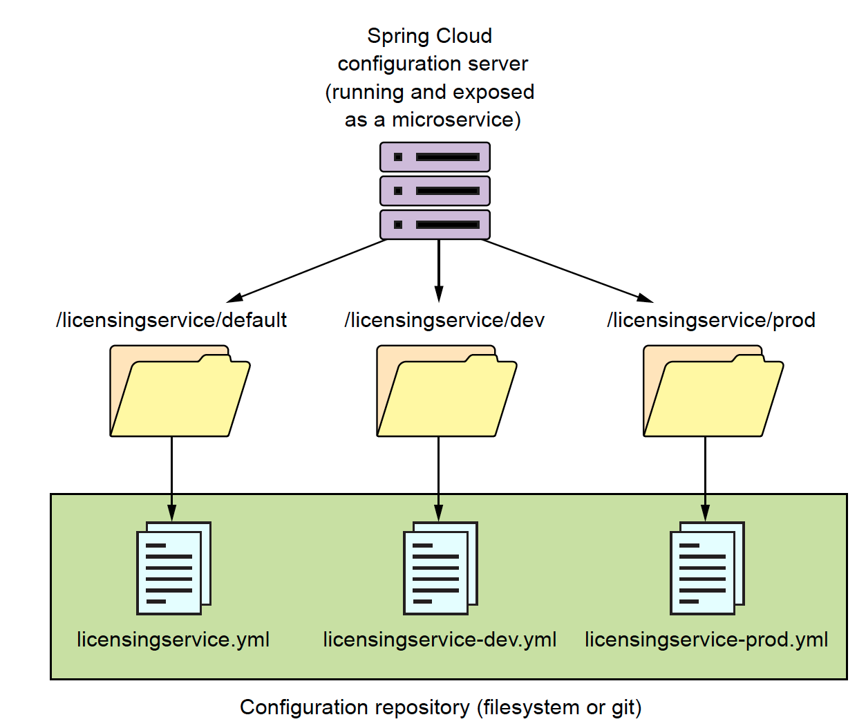
Anatomy Spring Cloud Config
Spring Cloud Config is a configuration repository for holding service data
As a Spring Boot service starts it will pull down the configuration from the Spring Cloud Config service
Spring Cloud Config
Is exposed as REST-based microservice
Integrates tightly with Spring properties
Supports multiple data stores (Consul, Eureka, GitHub)
Supports encryption of sensitive properties
Dynamic refreshing of properties
Ensures that every instance of a service that boots will have the exact same configuration
Configuration management is a critical part of any service management environment
Notes:
One of my personal favor repositories is using github. You automatically get versioning for deployment options.

Slide 14
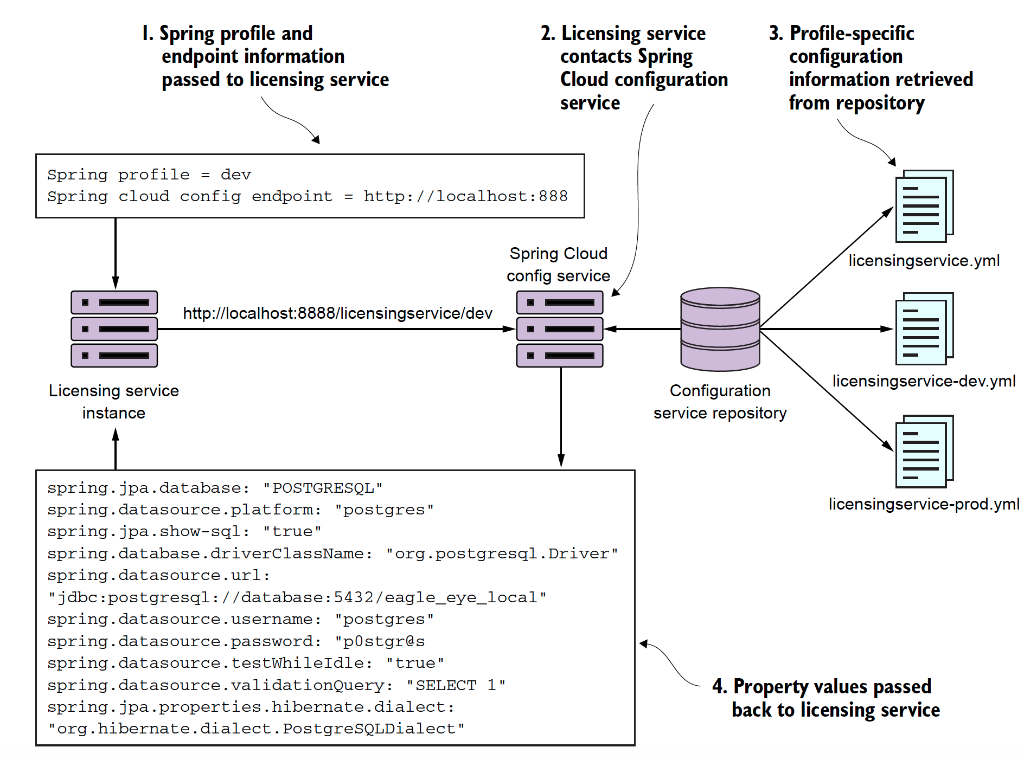
Spring Cloud Config in Action
Notes:
Lets go look a the code.

Slide 15
Service discovery and routing with Spring Cloud, Netflix Eureka and Zuul

Slide 16
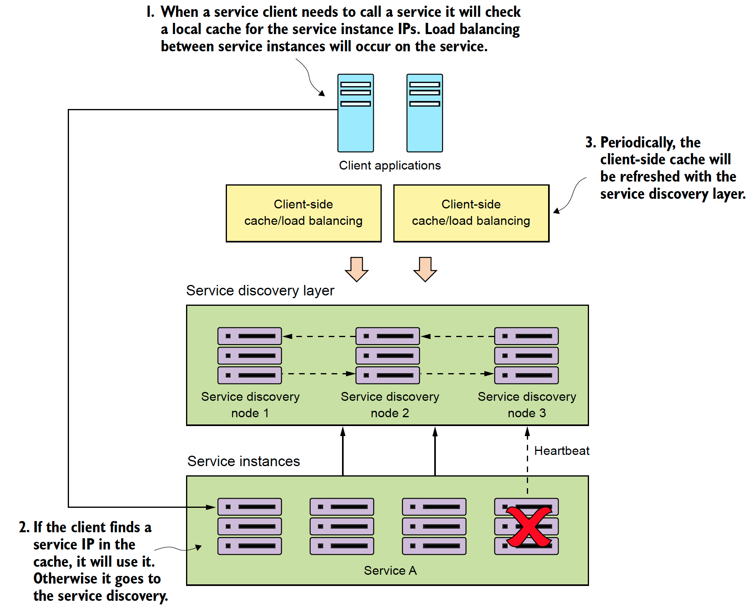
Service Discovery: Finding Your Service
Service discovery is the mechanism in which clients locate an instance of a service.
Service registration
Client lookup
Health monitoring
Resiliency and redundancy
Notes:
The important thing to note with service discovery is that it allows you to spin up large number of services quickly without a client having to explicitly know about them. This is huge because it allows you to scale quickly.
- Not just for performance reasons
I have spent many years during a critsit wishing I could quickly spin up new instances of web sphere services
3 ways to do service discovery:
EurekaEnabled RestTemplate
Discovery Service
Feign Ribbon

Slide 17
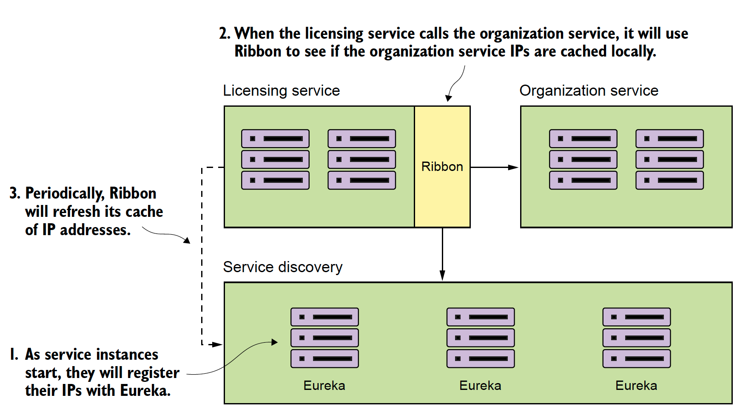
Feign and Ribbon: How a Spring client finds a service
Notes:
Lets look at some code

Slide 18
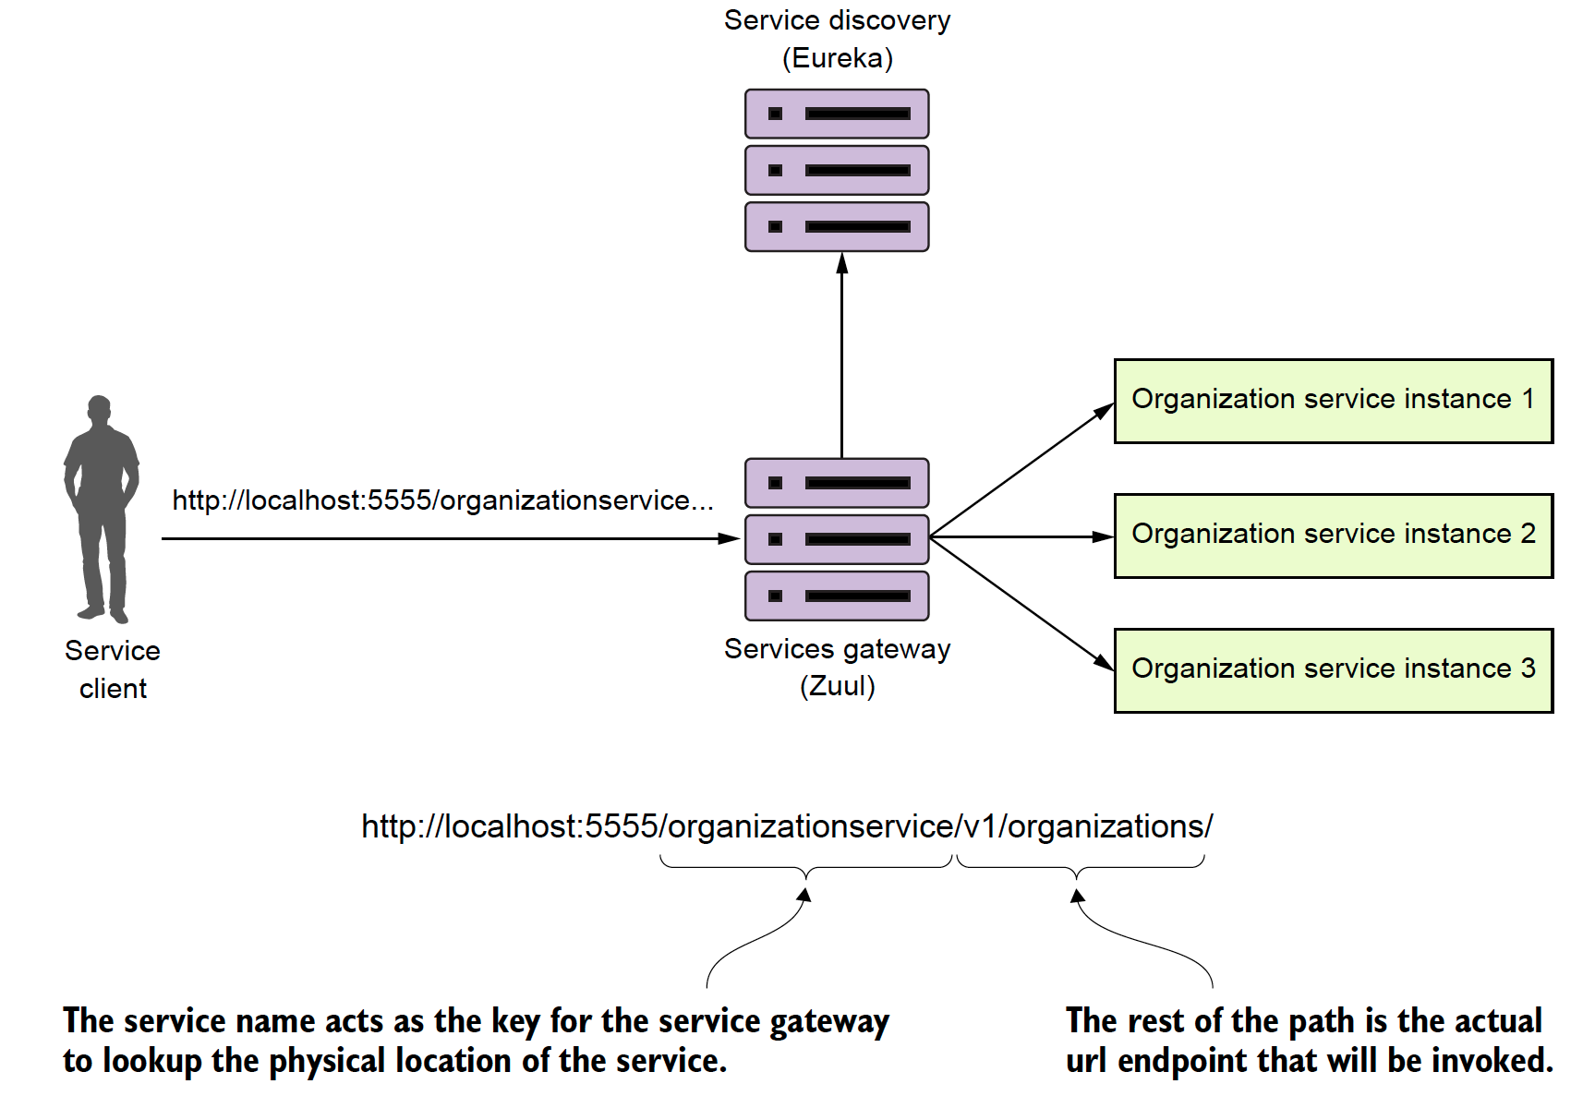
Spring Cloud and Zuul: Building a service gateway
A service gateway acts an intermediary between the service client and the service.
Service client has a single URL to invoke.
Service gateway acts as a traffic cop.
Service gateway acts as a Policy Enforcement Point (PEP)
Static routing
Dynamic routing
Authentication/Authorization
Metric collection, rate limiting
Notes:
Zuul is a very cool technology. it allows you to proxy requests and it allows you to do pre-post filters along with dynamic routing. Uses of include:
1. Custom security and policy enforcement (every call must have certain headers).
2. Header and content manipulation. (Correlation id injection
3 Content manipulation anddynamic routing

Slide 19
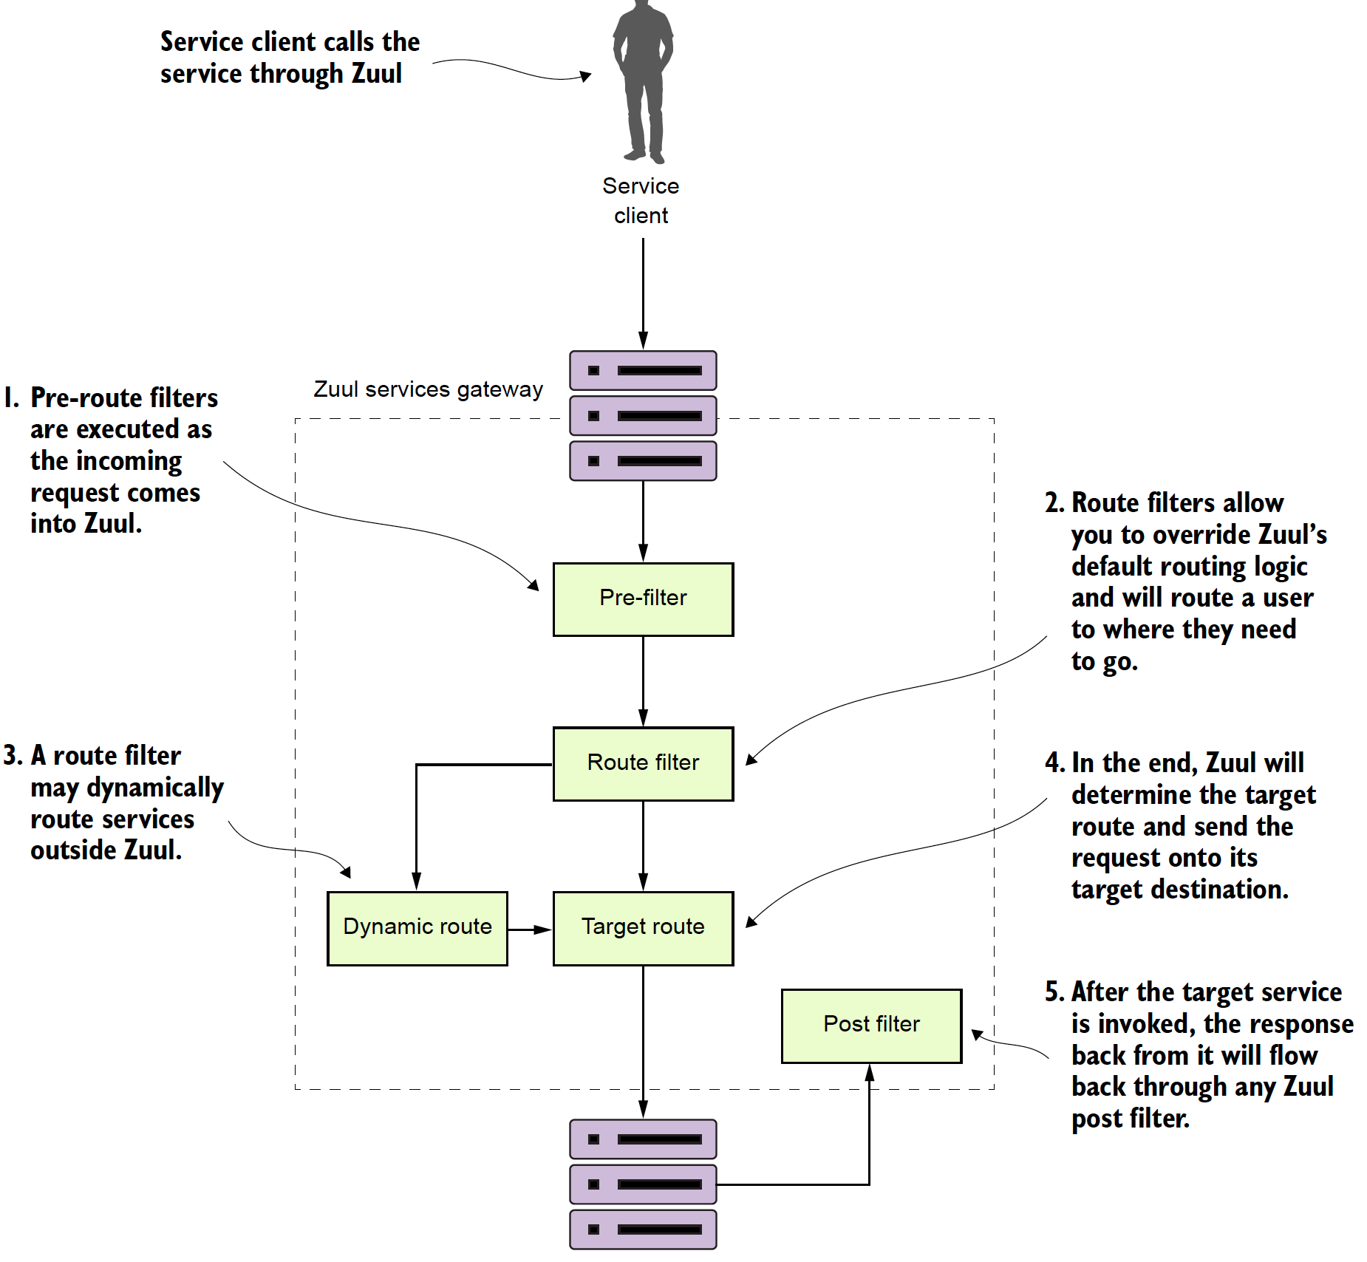
Spring Cloud: Policy Enforcement

Slide 20
Client-side resiliency with Spring Cloud and Hystrix
Notes:
For about 5 years I did

Slide 21
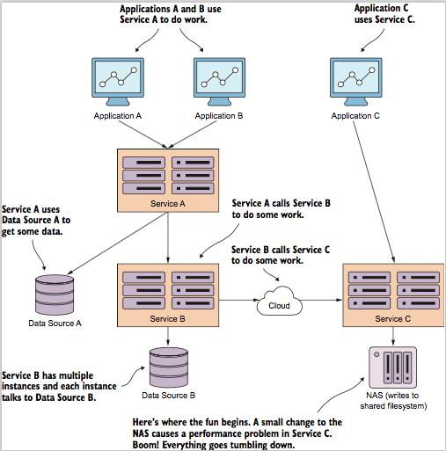
Ever have one of those days?
Bad things happen, but they really happen in truly spectacular fashion
In distributed systems, outages are more often then not caused by degradation of a component.
Client resiliency patterns help protect the clients consuming a service.
They also help a service that is running in a degraded state by taking pressure off the system.

Slide 22
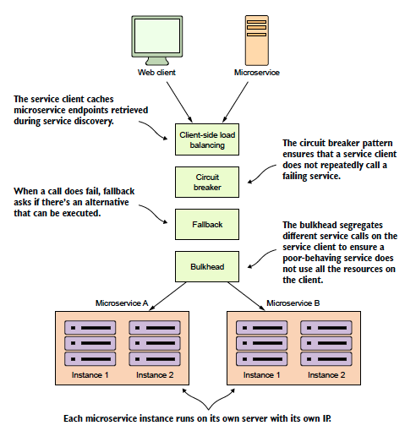
Spring Cloud and Hystrix

Slide 23
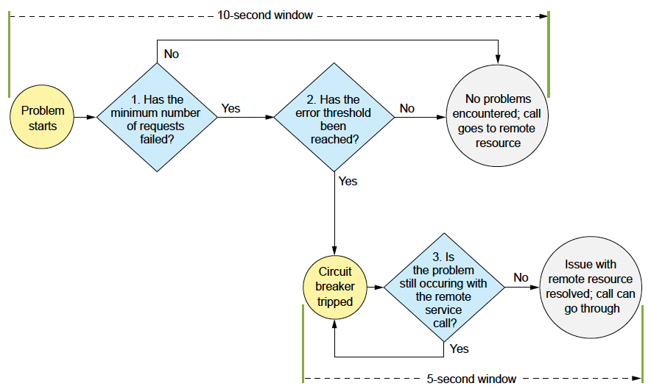
Popping a circuit on a bad call

Slide 24
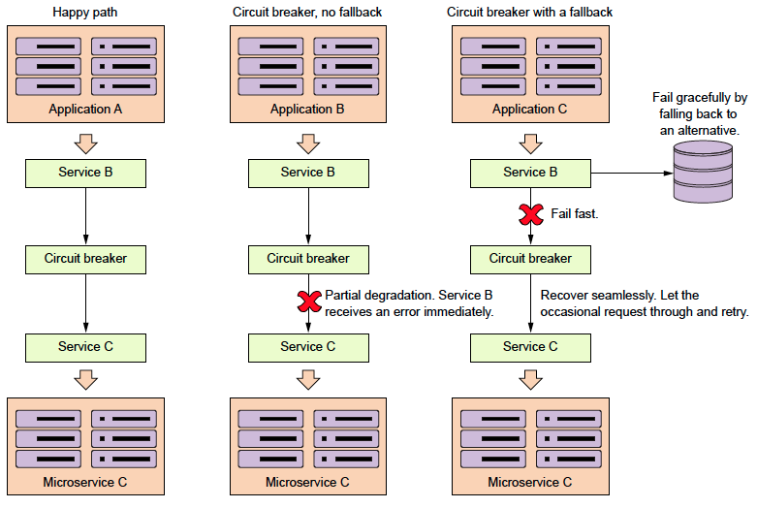
Always have a plan b: Fallback’s in Hystrix

Slide 25
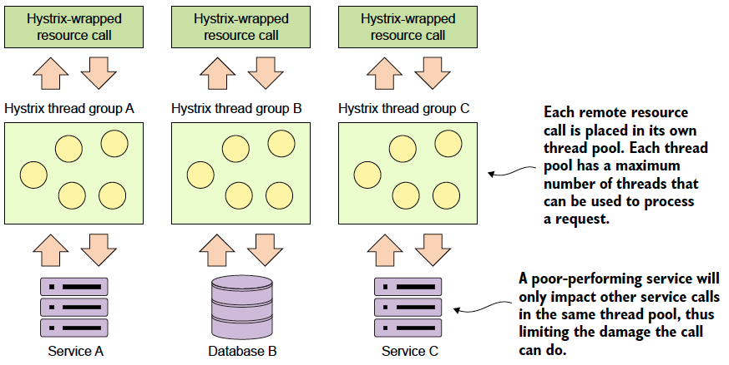
Saving the ship with bulkheads

Slide 26
Event driven microservices with Spring Cloud Stream

Slide 27
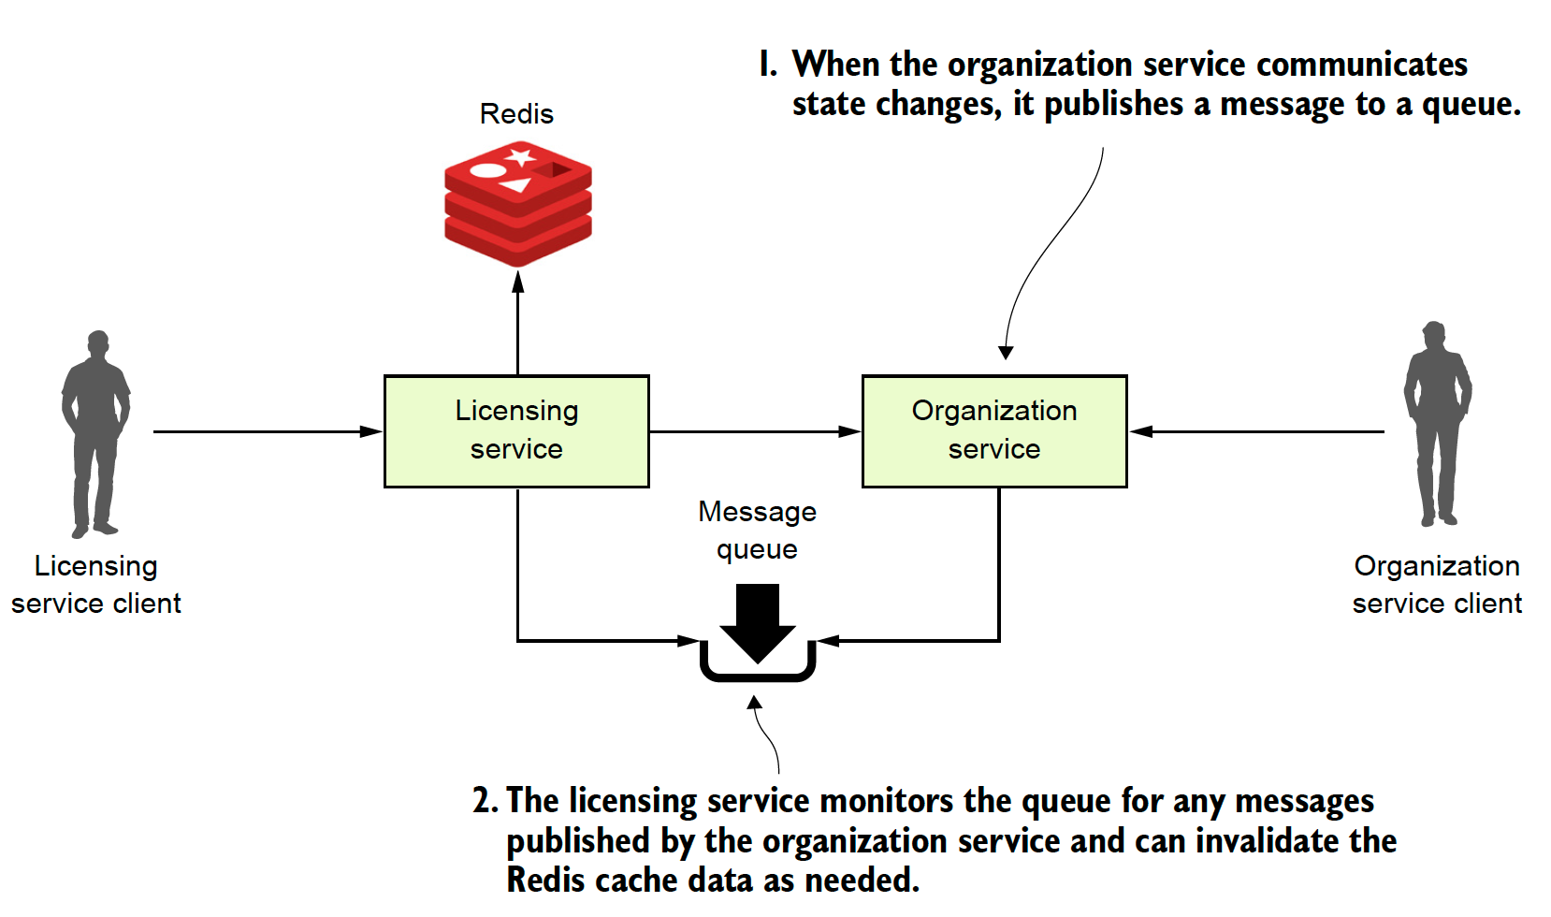
Event Driven Architecture with Spring Cloud Stream
Notes:
This is going to be a simple example and you might ask why I dont use Spring Cache.

Slide 28
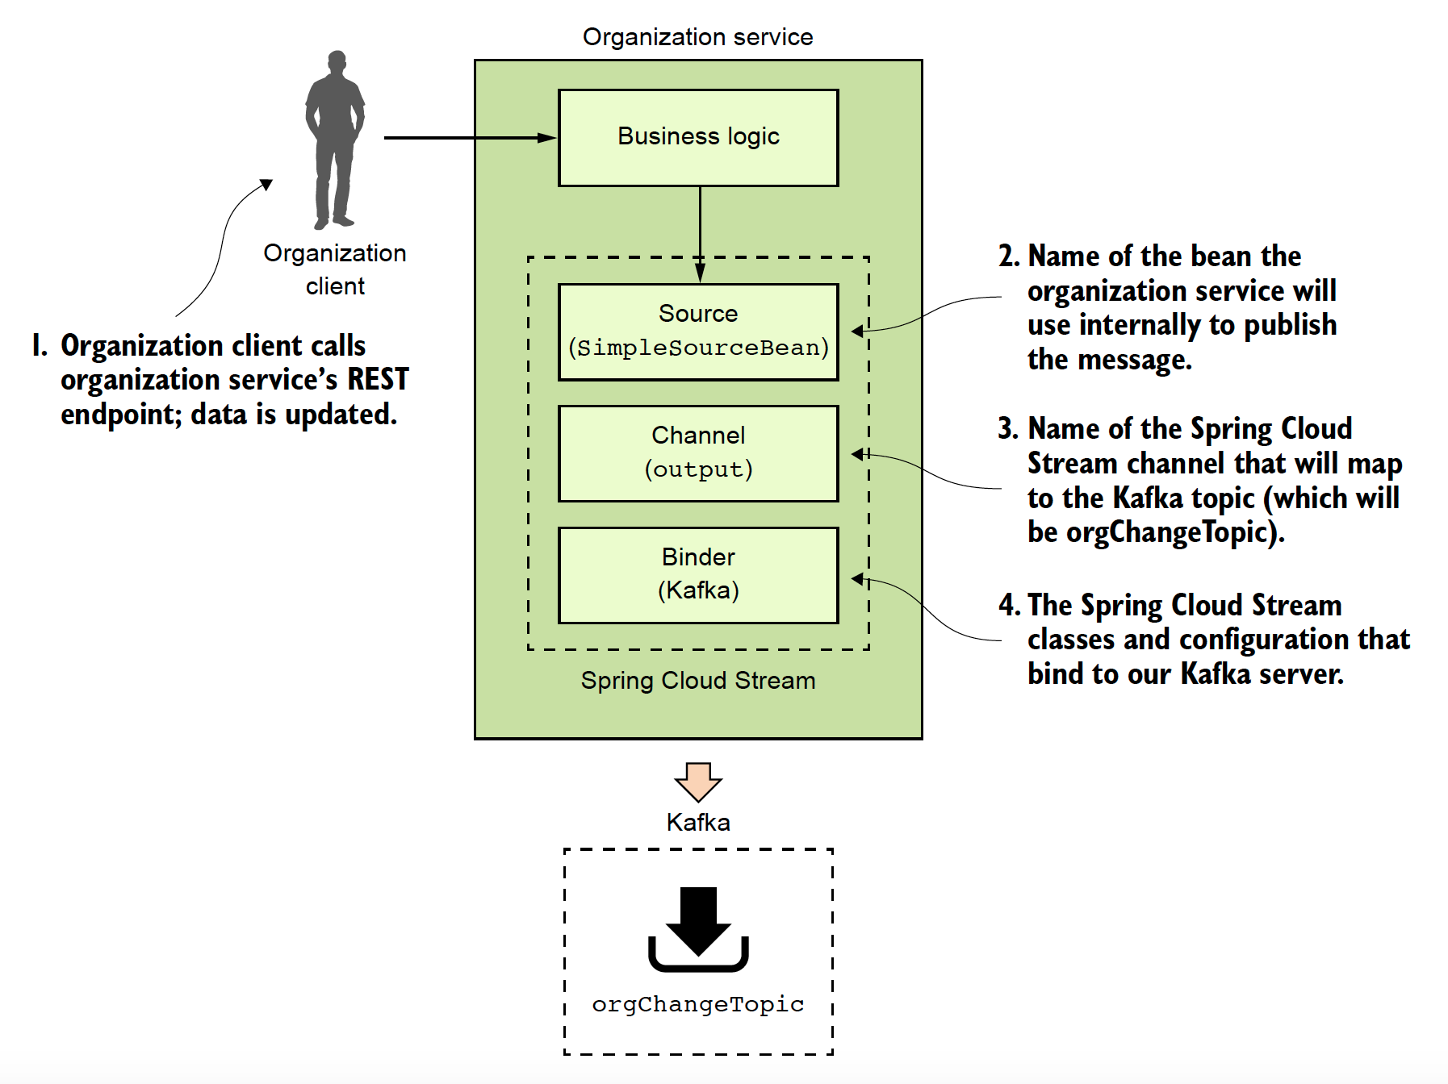
Spring Cloud Stream: Message Producer

Slide 29
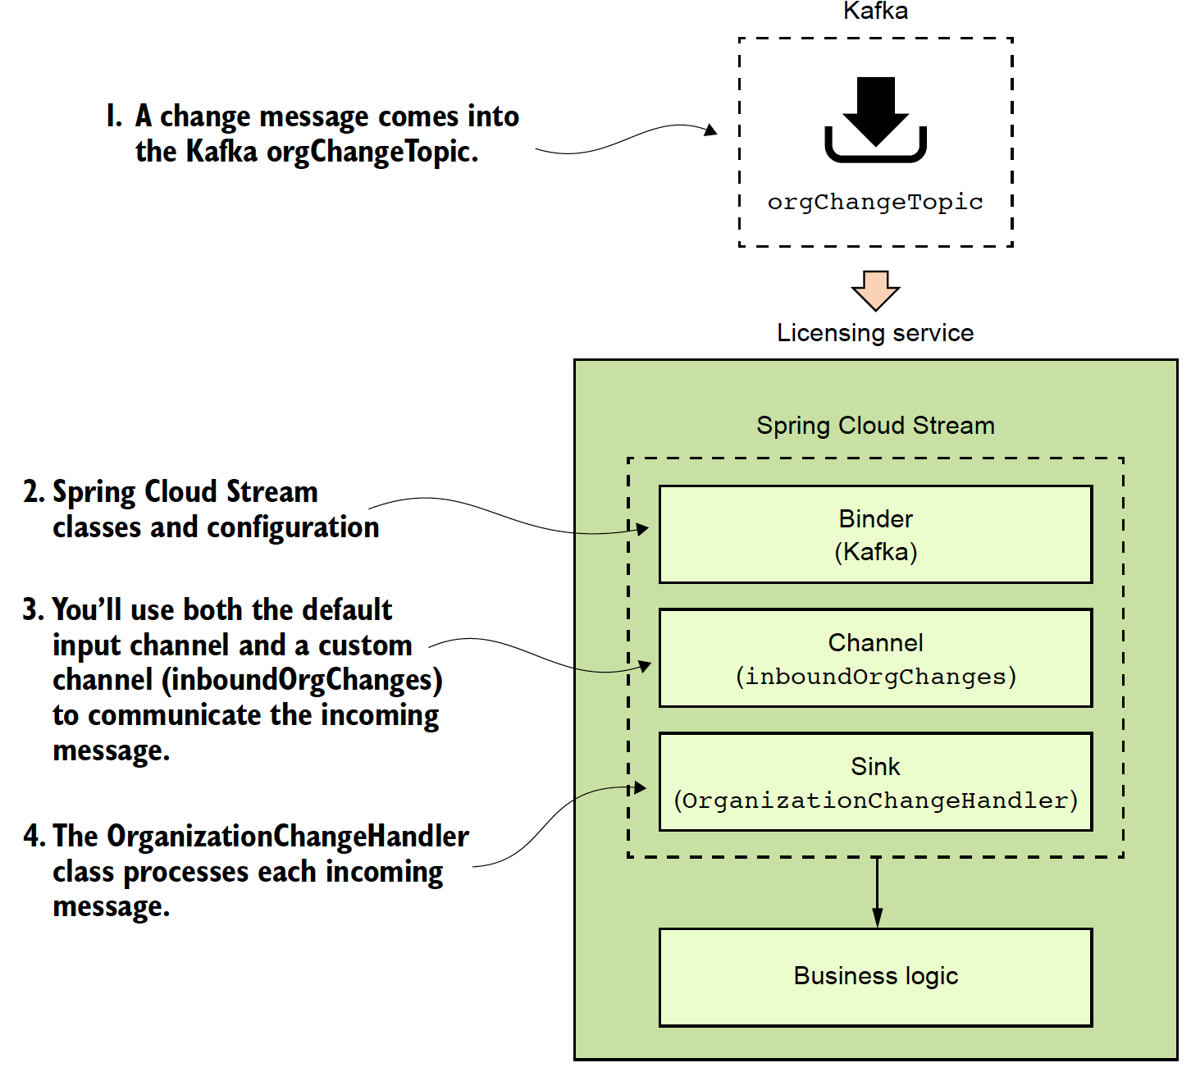
Spring Cloud Stream: Message Consumer

Slide 30
Distributed service tracing with Spring Cloud Sleuth
Notes:
Microservice architectures are great because they break everything down into small pieces. Microservice architectures are extremely painful to debug because they break everything down into small pieces (especially if you have multiple teams). Log correlation, aggregation and tracing are critical to the success of your application because when u need logging (eg. critsits) is often when you dont have it.). We are going to look at how we can use Spring Cloud Sleuth with tools like Papertrail and Zipkin

Slide 31
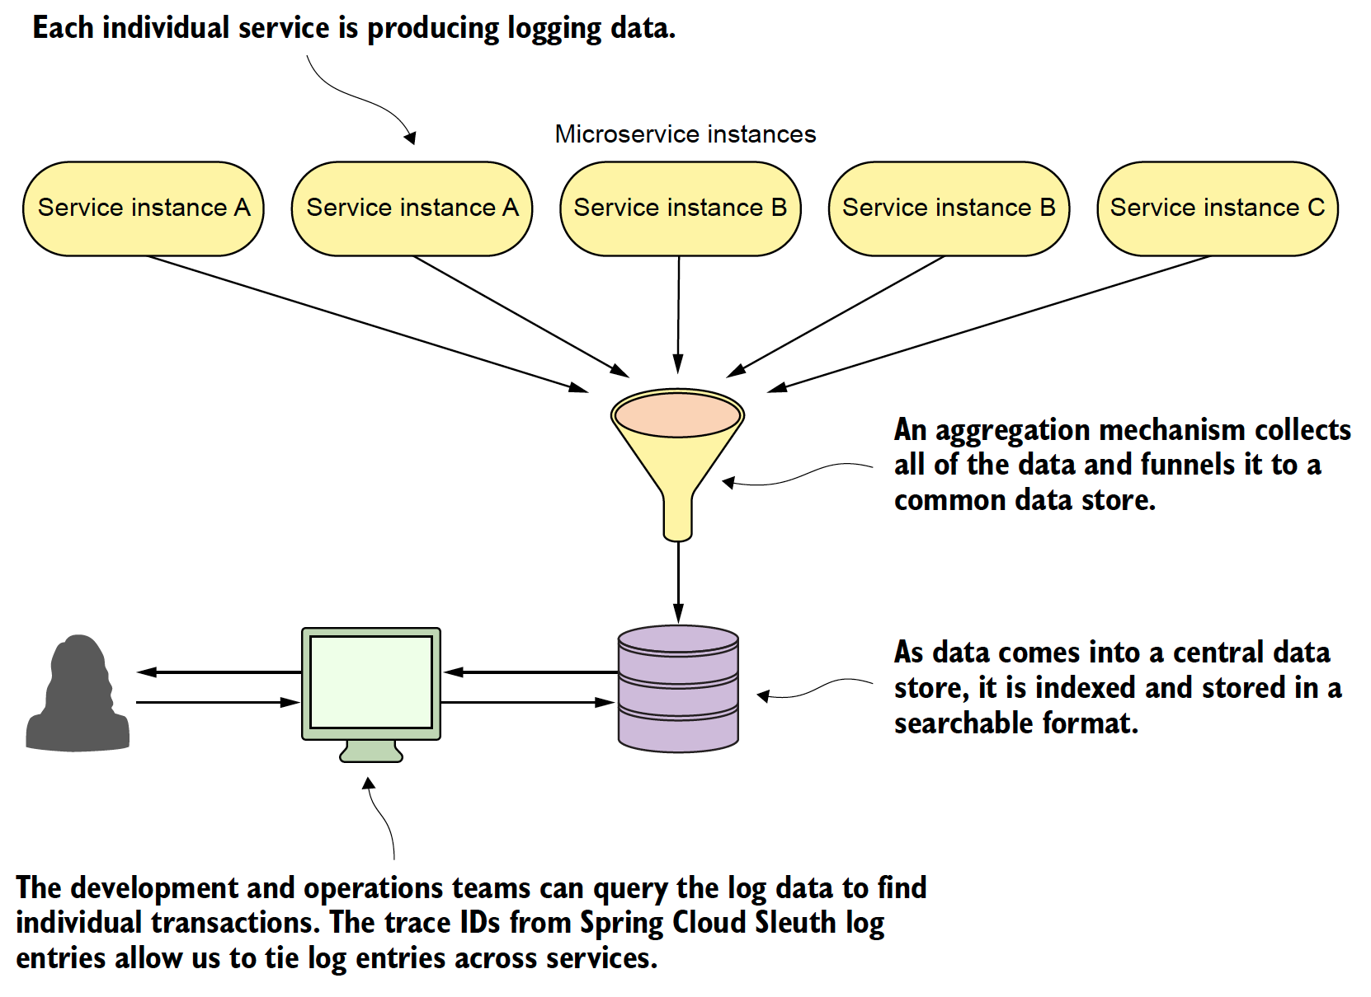
Log Aggregation and Distributed Tracing
Notes:
Log aggregation

Slide 32
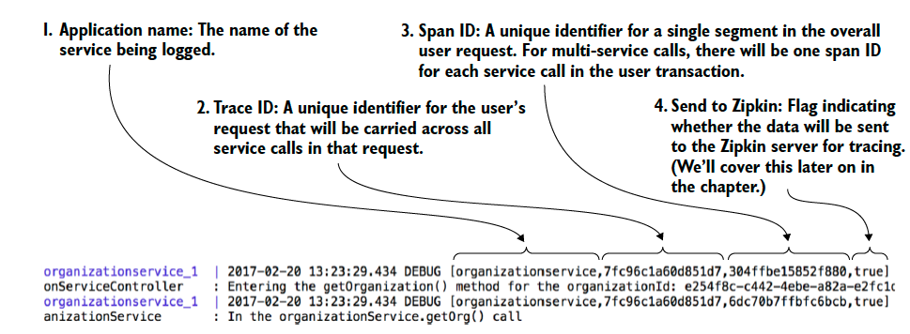
Step 1: Setting up Spring Cloud Sleuth
<dependency> <groupId>org.springframework.cloud</groupId> <artifactId>spring-cloud-stream</artifactId> </dependency>
Notes:
Spring Cloud sleuth really does a lot of behind the scenes magic with generating trace ids (correlation ids) and then making sure each segment of a call is broken down in a unique span.

Slide 33
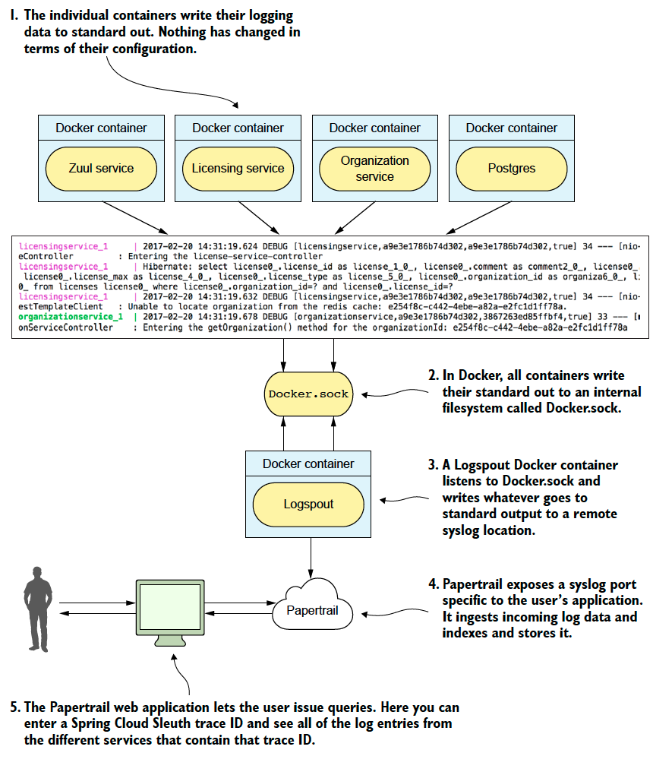
Step 2: Log Aggregation with Spring Cloud Sleuth and Papertrail
Notes:
Papertrail is just one log aggregation tool

Slide 34
Step 3: Integrating Spring Cloud Stream with Zipkin
spring:
zipkin:
baseUrl: localhost:9411 <-Change to the URL of your Zipkin service

Slide 35
Closing Thoughts

Slide 36
Closing thoughts
Spring Cloud has a large number of parts and is growing:
What we did not cover
Spring Cloud Security
Microservice Deployment
Spring Cloud with AWS
Spring Cloud Data Flow
Spring Cloud Contract
Beyond microservices
Lambdas
Functions as a Service (FaaS)

Slide 37
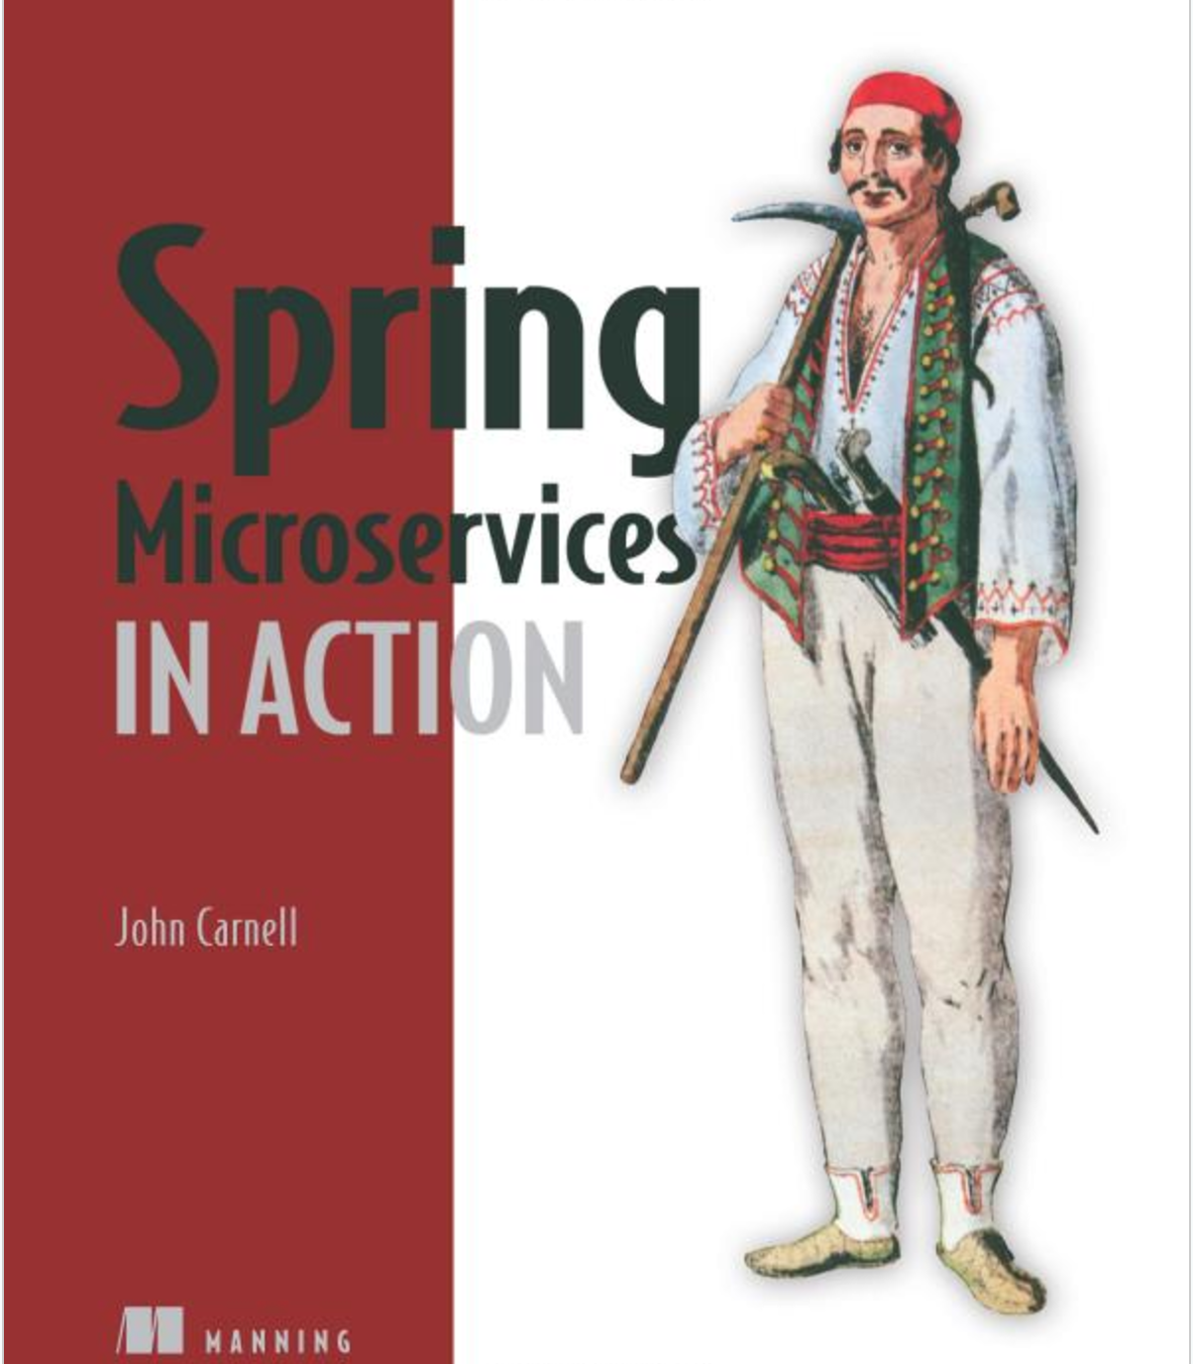
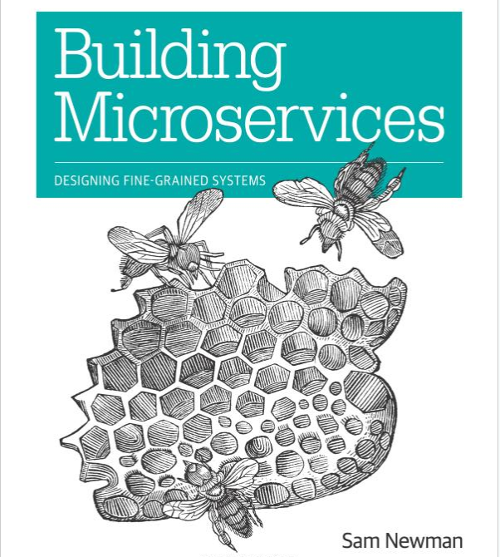

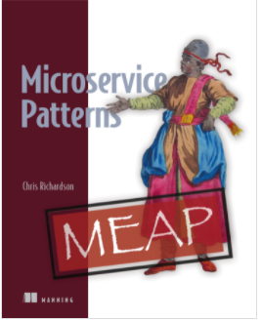
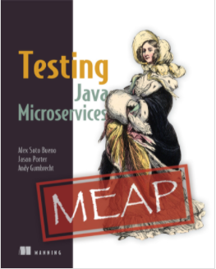
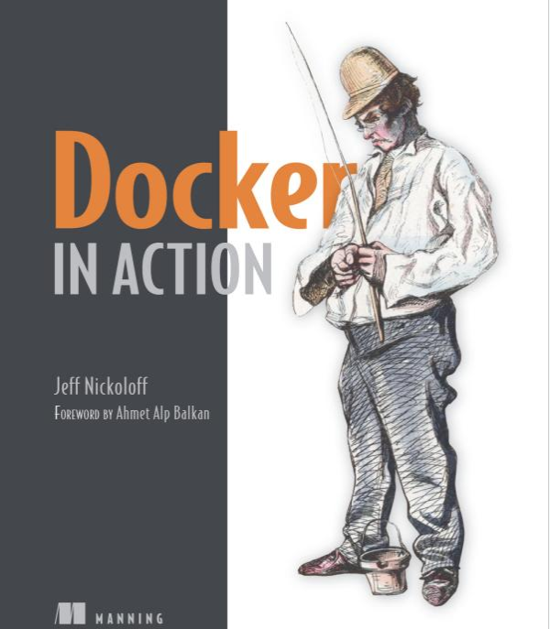
Other Microservice Resources

Slide 38
Questions

